Slide 1
TOWARDS A RESEARCH FRAMEWORK FOR A HUMAN DEVELOPMENT-BASED “BOTTOM OF THE PYRAMID” ICT DEVELOPMENT STRATEGY IN SOUTH AFRICA
Authors:
Walter Brown, Monash SA, 144 Peter Road, Ruimsig, South Africa. walbrown@mail.ngo.za
Irwin Brown, University of Cape Town, Private Bag, Rondebosch, 7701, Cape Town, South Africa.
Irwin.Brown@uct.ac.za
Session 58: Information Systems Development
Tuesday 9th June 2009, 16:00 – 17:30.
Notes:
166

Slide 2
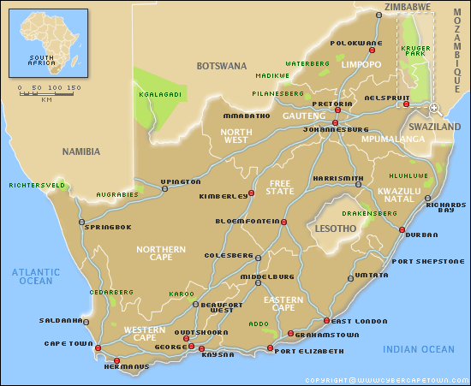
Why
South Africa?
Notes:
166

Slide 3
Maybe because we’re ALL South Africans
Migration: Peopling the world, 56k years ago: Hua Lui et al, 2006: Everybody’s Ancestral Cousins!
Human Footprints: 124k years ago
  Jacobs and Roberts, 2009
Birth of Language, Culture, Society? 77k years ago: Blombos:
Henshilwood et al: 2002
Birth of Technology? Sibudu: 60K years ago: Jacobs, Roberts et al, 2007.
Notes:
166

Slide 4
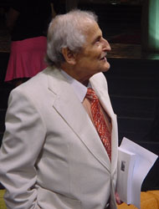
I am an African!
Philip Tobias: Scientist
Quoted from Tobias’ Bodies: Award winning Video Documentary, 2002
“The human species has a genetic pre-disposition of being extremely violent……… and very caring……
Culture & Environment determines whether we kill….. or care……
Society creates us and our behavior, but we create society
Therefore, we are in a position to re-create ourselves…
To master our genetic propensity for violence”
Human Inequality is a Form of Extreme Violence!
Can ICTs Help Recreate a Less Violent Society?
Notes:
166

Slide 5
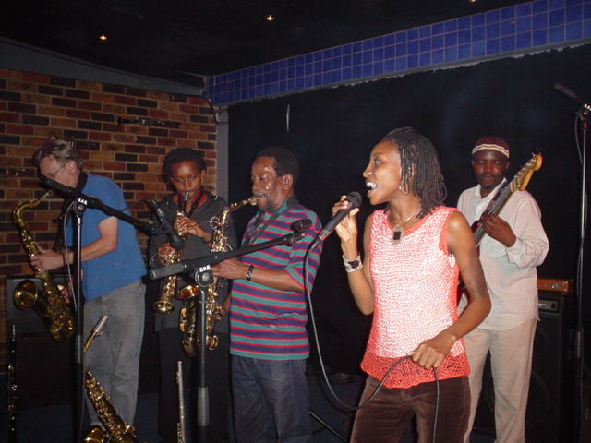
The “Wembe” Family
Very Talented...Very Poor!
Can IS Promote their Talent and Reduce their Poverty?
Notes:
166

Slide 6
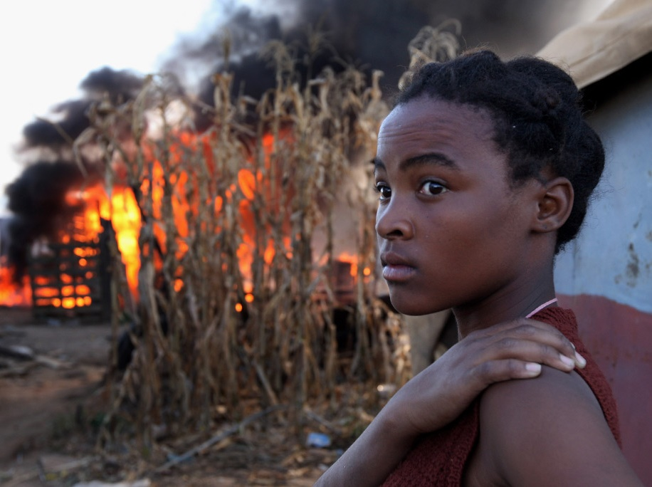
Xenophobic Frenzy: May 2008
60 Deaths; 40,000 Displaced.
Can Information Systems Deliver Knowledge to prevent such Human Disasters?
Notes:
166

Slide 7
Human Development
“the process of enlarging people’s choices. Their three essential choices are:
  To live a long and healthy life
  To acquire Knowledge
  To have access to the resources needed for a decent standard of living
OECD
Notes:
South Africa (HDI Rank: 120): A Golden Opportunity – A Major Challenge
South Africa’s unique strengths:
The “Cradle” of humankind (Sterkfontein), and Modern Humans (Kalahari);
A Microcosm of a multi-ethnic multi-cultural “colourful” world that finds strength in cultural diversity;
A nation rich in historical experience - a disastrous human history presenting a powerful messages for the future;
A land rich in natural resources – human and other;
A significant “First Economy” that can contribute to “Second Economy” development – if allowed to, and encouraged to do so.
South Africa’s risks:
Failure to raise the national level of human development;
The consequential response of the massive “Second Economy” to its “exclusion” from “First Economy” advantages;
Failure to build the tools required for inclusive human development – affordable effective ICTs.
South Africa’s opportunity: Use the intellectual capacity of South Africa’s “First Economy” to build the ICT infrastructures that will address the knowledge access needs of South Africa’s “Second Economy” – true ICTs4D4ALL, addressing leading edge economic challenges, and developing country demands simultaneously, effectively.

Slide 8
Choice 1: A Long and Healthy Life
Probability of surviving to age 65: S. Africa 34%: S. Korea 79%
Life expectancy at birth: S. Africa 53 years: S. Korea 77 years
HIV Prevalence: S. Africa 18.8%: S. Korea <0.1%
S. Africa
Thailand
Colombia
Turkey
S. Korea
90
20
80
18
70
18.8%
16
78.6%
14
60
72%
71.7 years
69%
68.6 years
12
50
57.8%
77 years
HIV Prevalence (%)
Life expectancy at birth (years) & Probability of surviving to age 65 (%)
10
40
70.8years
53 years
8
30
6
20
1.4%
4
34%
<0.2%
10
0.6%
<0.1%
2
0
0
Probability of surviving to age 65 (%)
Life expectancy at birth (years)
HIV Prevalence (%)
Notes:
South Africa (HDI Rank: 120): A Golden Opportunity – A Major Challenge
South Africa’s unique strengths:
The “Cradle” of humankind (Sterkfontein), and Modern Humans (Kalahari);
A Microcosm of a multi-ethnic multi-cultural “colourful” world that finds strength in cultural diversity;
A nation rich in historical experience - a disastrous human history presenting a powerful messages for the future;
A land rich in natural resources – human and other;
A significant “First Economy” that can contribute to “Second Economy” development – if allowed to, and encouraged to do so.
South Africa’s risks:
Failure to raise the national level of human development;
The consequential response of the massive “Second Economy” to its “exclusion” from “First Economy” advantages;
Failure to build the tools required for inclusive human development – affordable effective ICTs.
South Africa’s opportunity: Use the intellectual capacity of South Africa’s “First Economy” to build the ICT infrastructures that will address the knowledge access needs of South Africa’s “Second Economy” – true ICTs4D4ALL, addressing leading edge economic challenges, and developing country demands simultaneously, effectively.

Slide 9
Choice: To Acquire knowledge
How Internationally Competitive are South Africans?
 | Grade 8 Maths Score TIMSS 2003 46 countries | Grade 8 Science Score TIMSS 2003 46 countries | Grade 4 Reading PIRLS 2006 40 countries
Highest Country (Score) | Singapore (605) | Singapore (578) | Russia (567)
International Average Country (Score) | Romania, Norway (467) | Jordan, Moldova (474) | Moldova, Belgium (500)
Lowest Country (Score) | South Africa (264) | South Africa (244) | South Africa (306)
57% Below Average
51% Below Average
61% Below Average
Notes:
South Africa (HDI Rank: 120): A Golden Opportunity – A Major Challenge
South Africa’s unique strengths:
The “Cradle” of humankind (Sterkfontein), and Modern Humans (Kalahari);
A Microcosm of a multi-ethnic multi-cultural “colourful” world that finds strength in cultural diversity;
A nation rich in historical experience - a disastrous human history presenting a powerful messages for the future;
A land rich in natural resources – human and other;
A significant “First Economy” that can contribute to “Second Economy” development – if allowed to, and encouraged to do so.
South Africa’s risks:
Failure to raise the national level of human development;
The consequential response of the massive “Second Economy” to its “exclusion” from “First Economy” advantages;
Failure to build the tools required for inclusive human development – affordable effective ICTs.
South Africa’s opportunity: Use the intellectual capacity of South Africa’s “First Economy” to build the ICT infrastructures that will address the knowledge access needs of South Africa’s “Second Economy” – true ICTs4D4ALL, addressing leading edge economic challenges, and developing country demands simultaneously, effectively.

Slide 10
A Nation fragmented by historical divisions:
African (aka “Black” or “Black African”)
Coloured (usually mixed Black/Indian/White Ancestry)
Indian (of Indian, Pakistani, Malay, Nepalese Ancestry)
White (aka European, any ancestor continent)
Racial Inequality in Education
Race classifications retained for official monitoring
Percentage of South Africans with 12+ years of formal education
% of population
African
26.0%
79.5%
26.0%
26.0%
Coloured
30.2%
8.8%
30.2%
30.2%
Indian
54.6%
2.5%
54.6%
54.6%
White
78.5%
9.2%
78.5%
78.5%
0%
10%
20%
30%
40%
50%
60%
70%
80%
Chart derived from Statistics South Africa Survey 2006/2007

Slide 11
A Direct Correlation Between Learning and Poverty
Children of the poor underachieve in later life, Perpetuating Poverty…
The Stress of Living in Poverty Affects Children’s Brain Development.....
In USA, $10,000 pa increase for mid-income family= 16% increase in graduations. Same for low income families = 600% more graduates……..
In South Africa: 58% live on less than $620 pa. Are they Poor? Are their Children Stressed? Are their Brains Safe?
Can Traditional Education Reverse this Brain Damage?
The Future is Bleak if we don’t deal with Poverty, Quickly..
Poverty, Privilege, and Brain Development: Empirical findings and Ethical Implications: M. Farah et al: Pennsylvania University, 2008
Chaos, Helplessness and Achievement: C. Genero, Cornel University, 2008

Slide 12
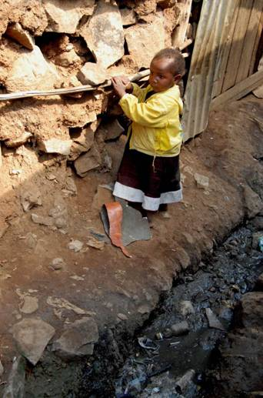
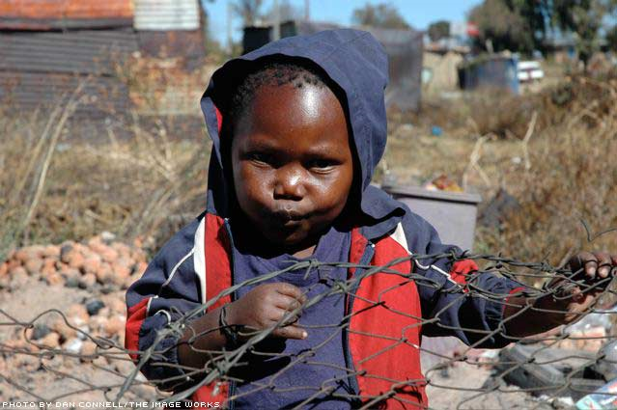
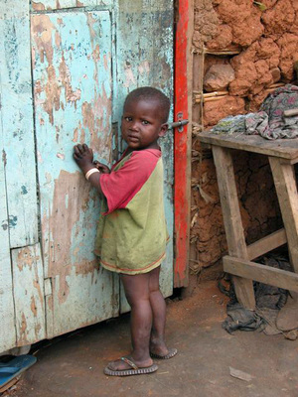
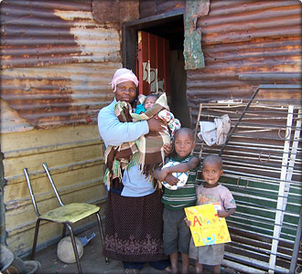
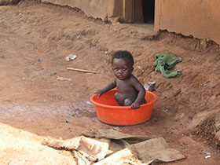
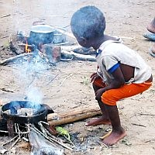
50 to 70% of South Africa’s Children
And You Still Think I can Pass Matric?
More Stressed
Severely Stressed
Very Stressed
Highly Stressed
Stressed
Critically Stressed

Slide 13
Choice: Access to Resources
Update 2008: South Africa Ranked 125th!
25000
180
`
160
20000
140
$22029
120
15000
159
169
147
135
121
100
GDP per Capita: US$ PPP 2005
105
Human Development Rank
78
80
10000
$11110
81
75
$8677
60
$3071
$7304
40
5000
$2480
$6757
$2083
$1055
26
20
$744
0
0
Tanzania
Ethiopia
Sudan
Ghana
S. Africa
Viet Nam
China
Thailand
S. Korea
Colombia
Iceland:
1
$36510
Lebanon:
88
$5584
Sierra Leone:
177
$806
Data: 2000 - 2005
Source: UN HDR 2007/2008
Notes:
South Africa (HDI Rank: 120): A Golden Opportunity – A Major Challenge
South Africa’s unique strengths:
The “Cradle” of humankind (Sterkfontein), and Modern Humans (Kalahari);
A Microcosm of a multi-ethnic multi-cultural “colourful” world that finds strength in cultural diversity;
A nation rich in historical experience - a disastrous human history presenting a powerful messages for the future;
A land rich in natural resources – human and other;
A significant “First Economy” that can contribute to “Second Economy” development – if allowed to, and encouraged to do so.
South Africa’s risks:
Failure to raise the national level of human development;
The consequential response of the massive “Second Economy” to its “exclusion” from “First Economy” advantages;
Failure to build the tools required for inclusive human development – affordable effective ICTs.
South Africa’s opportunity: Use the intellectual capacity of South Africa’s “First Economy” to build the ICT infrastructures that will address the knowledge access needs of South Africa’s “Second Economy” – true ICTs4D4ALL, addressing leading edge economic challenges, and developing country demands simultaneously, effectively.

Slide 14
Inequality: A Provocative Social Issue
South Africa ranks 9th most unequal country in the world (UN)
SA President’s Report 2008:
GINI 69
10% Ratio 92
70
63.8
70
60
57.8
60
46.9
58.6
50
50
40.8
42.5
42
40
34.6
33.1
34.4
40
GINI Coefficient
Ratio 10% Richest to 10% Poorest
30
28.4
30
30
21.6
20
14.1
13.6
20
12.6
6.6
9.2
6.9
10
5.9
10
0
0
Ethiopia
Tanzania
Ghana
Kenya
S. Korea
Viet Nam
Thailand
China
Colombia
South Africa
Japan: Most Equal:
24.9
3.4
Namibia: Most Unequal
74.3
129
Data: 2005
Source: UN HDR 2007/2008

Slide 15



Economic Growth driven by Access to Knowledge
Source: ITU World Telecommunication Indicators 2004
16000
60
16000
Wealth Creation Intimately Linked to Access to Knowledge
14000
14000
50
12000
12000
40
10000
10000
GDP per Capita (US$)
30
8000
Telephone Density ( %)
8000
6000
6000
20
4000
4000
10
2000
2000
0
0
1970
1970
1980
1980
1990
1990
2000
2000
Spain
South Korea
South Africa
Colombia

Slide 16
ICT Pricing: The Most Damaging Aspect of ICTs in South Africa
Broadband Prices: 1Mb/s Uncapped and Unshaped US$ per month:
Afghanistan: $487
India: $93
Pakistan $33
South Africa: $247 to $633 (As advertised 2009)
Japan $0.4 Based on $60 for 160Mb/s, 30GB Upload Data Cap per Day
Source: lirneasia broadband price benchmarks 2009
Devastating Impact
on Poverty
&
Human
Development
2nd Economy
10.5%
51.4%
South Africa
13.3%
1st Economy
0.8%
5.2
%
Colombia
3.2
%
Source:
http://
www.nationmaster.com
Thailand
2.8
%
Internet Data for 2005: Mobile Data for 2006
Turkey
1.7
%
South Korea
2.2
%
0%
10%
20%
30%
40%
50%
60%
% GDP per Capita (PPP) or mean income in SA 1st and 2nd Economies
Monthly Internet Price Baskets: 20 hours peak & off
-
peak no line rental.
Monthly Mobile Price Basket: 25 calls, 30 SMS, different networks and times.

Slide 17
A Golden Opportunity: NGN
ITU-T SG 13: Rec. Y.2001
A NGN is a packet-based network able to provide telecommunication services and able to make use of multiple broadband, QoS-enabled transport technologies and in which service-related functions are independent from underlying transport-related technologies. It enables unfettered access for users to networks and to competing service providers and/or services of their choice. It supports generalized mobility which will allow consistent and ubiquitous provision of services to users.
NGN in South Africa Aims to Deliver HDTV of FIFA 2010!
Can This be Changed to Focus on HD@BOP?
Notes:
South Africa (HDI Rank: 120): A Golden Opportunity – A Major Challenge
South Africa’s unique strengths:
The “Cradle” of humankind (Sterkfontein), and Modern Humans (Kalahari);
A Microcosm of a multi-ethnic multi-cultural “colourful” world that finds strength in cultural diversity;
A nation rich in historical experience - a disastrous human history presenting a powerful messages for the future;
A land rich in natural resources – human and other;
A significant “First Economy” that can contribute to “Second Economy” development – if allowed to, and encouraged to do so.
South Africa’s risks:
Failure to raise the national level of human development;
The consequential response of the massive “Second Economy” to its “exclusion” from “First Economy” advantages;
Failure to build the tools required for inclusive human development – affordable effective ICTs.
South Africa’s opportunity: Use the intellectual capacity of South Africa’s “First Economy” to build the ICT infrastructures that will address the knowledge access needs of South Africa’s “Second Economy” – true ICTs4D4ALL, addressing leading edge economic challenges, and developing country demands simultaneously, effectively.

Slide 18
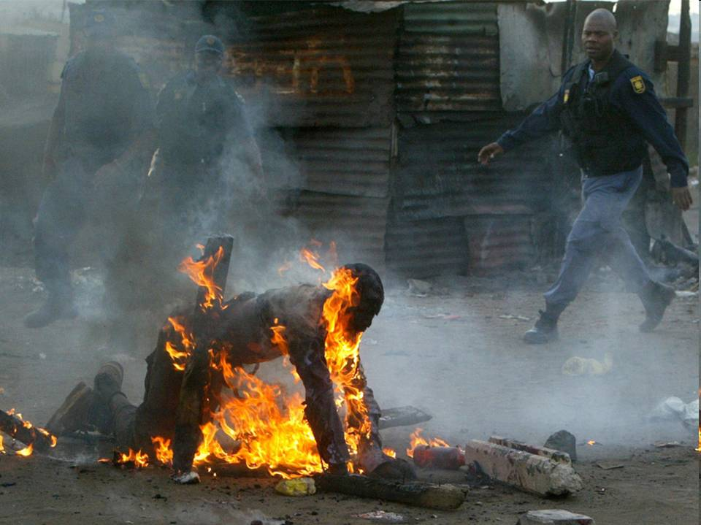
Johannesburg: 18 May 2008
If we do nothing.....
“We maintain that if a state is to avoid the greatest plague of all - I mean civil war, though civil disintegration would be a better term - extreme poverty and wealth must not be allowed to arise in any section of the citizen-body, because both lead to both these disasters”
Plato (circa 400 BC)
(STRINGER/AFP/Getty Images)
Notes:
South Africa (HDI Rank: 120): A Golden Opportunity – A Major Challenge
South Africa’s unique strengths:
The “Cradle” of humankind (Sterkfontein), and Modern Humans (Kalahari);
A Microcosm of a multi-ethnic multi-cultural “colourful” world that finds strength in cultural diversity;
A nation rich in historical experience - a disastrous human history presenting a powerful messages for the future;
A land rich in natural resources – human and other;
A significant “First Economy” that can contribute to “Second Economy” development – if allowed to, and encouraged to do so.
South Africa’s risks:
Failure to raise the national level of human development;
The consequential response of the massive “Second Economy” to its “exclusion” from “First Economy” advantages;
Failure to build the tools required for inclusive human development – affordable effective ICTs.
South Africa’s opportunity: Use the intellectual capacity of South Africa’s “First Economy” to build the ICT infrastructures that will address the knowledge access needs of South Africa’s “Second Economy” – true ICTs4D4ALL, addressing leading edge economic challenges, and developing country demands simultaneously, effectively.

Slide 19
Johannesburg: 18 May 2008
If we do nothing.....
“The divide between the income rich and income poor, the technology haves and technology have-nots, the information rich and information poor, has become the most serious political economic problem facing the world today”
Govindan Parayil (2005 AD)
Is there a Role for IS Research?
(STRINGER/AFP/Getty Images)
Notes:
South Africa (HDI Rank: 120): A Golden Opportunity – A Major Challenge
South Africa’s unique strengths:
The “Cradle” of humankind (Sterkfontein), and Modern Humans (Kalahari);
A Microcosm of a multi-ethnic multi-cultural “colourful” world that finds strength in cultural diversity;
A nation rich in historical experience - a disastrous human history presenting a powerful messages for the future;
A land rich in natural resources – human and other;
A significant “First Economy” that can contribute to “Second Economy” development – if allowed to, and encouraged to do so.
South Africa’s risks:
Failure to raise the national level of human development;
The consequential response of the massive “Second Economy” to its “exclusion” from “First Economy” advantages;
Failure to build the tools required for inclusive human development – affordable effective ICTs.
South Africa’s opportunity: Use the intellectual capacity of South Africa’s “First Economy” to build the ICT infrastructures that will address the knowledge access needs of South Africa’s “Second Economy” – true ICTs4D4ALL, addressing leading edge economic challenges, and developing country demands simultaneously, effectively.

Slide 20
Where to next?
Deliver Knowledge for Balanced Human Development via ICTs Affordably Accessed and Useable by All Citizens at the Bottom of the Pyramid (BOP)
Can IS Research Focus on this Need?
Notes:
South Africa (HDI Rank: 120): A Golden Opportunity – A Major Challenge
South Africa’s unique strengths:
The “Cradle” of humankind (Sterkfontein), and Modern Humans (Kalahari);
A Microcosm of a multi-ethnic multi-cultural “colourful” world that finds strength in cultural diversity;
A nation rich in historical experience - a disastrous human history presenting a powerful messages for the future;
A land rich in natural resources – human and other;
A significant “First Economy” that can contribute to “Second Economy” development – if allowed to, and encouraged to do so.
South Africa’s risks:
Failure to raise the national level of human development;
The consequential response of the massive “Second Economy” to its “exclusion” from “First Economy” advantages;
Failure to build the tools required for inclusive human development – affordable effective ICTs.
South Africa’s opportunity: Use the intellectual capacity of South Africa’s “First Economy” to build the ICT infrastructures that will address the knowledge access needs of South Africa’s “Second Economy” – true ICTs4D4ALL, addressing leading edge economic challenges, and developing country demands simultaneously, effectively.

Slide 21
How?
Research ICT4HD@SA’sBOP:
  From the Bottom Up:
    That’s where the Challenges lie;
  By Multidisciplinary Teams:
    Human development is Complex:
    Health, Wealth, Knowledge, Communication: Specialists Needed;
  Simultaneously:
    HD Issues are Interrelated, Interdependent, Interconnected;
  With Multi-institutional Partners:
    Human Development is a Global Challenge: 4.5 Billion BOP Citizens; 33.6 million South Africans!
Notes:
South Africa (HDI Rank: 120): A Golden Opportunity – A Major Challenge
South Africa’s unique strengths:
The “Cradle” of humankind (Sterkfontein), and Modern Humans (Kalahari);
A Microcosm of a multi-ethnic multi-cultural “colourful” world that finds strength in cultural diversity;
A nation rich in historical experience - a disastrous human history presenting a powerful messages for the future;
A land rich in natural resources – human and other;
A significant “First Economy” that can contribute to “Second Economy” development – if allowed to, and encouraged to do so.
South Africa’s risks:
Failure to raise the national level of human development;
The consequential response of the massive “Second Economy” to its “exclusion” from “First Economy” advantages;
Failure to build the tools required for inclusive human development – affordable effective ICTs.
South Africa’s opportunity: Use the intellectual capacity of South Africa’s “First Economy” to build the ICT infrastructures that will address the knowledge access needs of South Africa’s “Second Economy” – true ICTs4D4ALL, addressing leading edge economic challenges, and developing country demands simultaneously, effectively.

Slide 22
How?
A Bottom-up Participative Action R&D Strategy
  Participative:
    Academic Specialists in Human Development and ICTs;
    Institutional Partners, Local, Government, International;
    Industry: ICT Operators, Equipment Vendors; Researchers
    NGOs, Civil Society, Community Organizations;
    BOP People, Businesses, Organizations;
  Action
    Research ➔ Develop ➔ Implement ➔ Plan ➔ Integrate
    Bottom-up R&D; Top-Down Integration
    National, Regional, Global Scalability
Notes:
South Africa (HDI Rank: 120): A Golden Opportunity – A Major Challenge
South Africa’s unique strengths:
The “Cradle” of humankind (Sterkfontein), and Modern Humans (Kalahari);
A Microcosm of a multi-ethnic multi-cultural “colourful” world that finds strength in cultural diversity;
A nation rich in historical experience - a disastrous human history presenting a powerful messages for the future;
A land rich in natural resources – human and other;
A significant “First Economy” that can contribute to “Second Economy” development – if allowed to, and encouraged to do so.
South Africa’s risks:
Failure to raise the national level of human development;
The consequential response of the massive “Second Economy” to its “exclusion” from “First Economy” advantages;
Failure to build the tools required for inclusive human development – affordable effective ICTs.
South Africa’s opportunity: Use the intellectual capacity of South Africa’s “First Economy” to build the ICT infrastructures that will address the knowledge access needs of South Africa’s “Second Economy” – true ICTs4D4ALL, addressing leading edge economic challenges, and developing country demands simultaneously, effectively.

Slide 23
What?
Expected outcomes:
  Improved Knowledge: Published academic papers, Reports;
  Practical BOP-suitable ICT networks, services, industry;
  Lower entry cost for BOP entrepreneurs;
  BOP-ICT market development and expansion
Activities:
  Phase 1 & 2: Partnership formation; Project Management Formation; Detailed Research project Design;
  Phase 3: Project implementation, continuous monitoring review & evaluation;
  Phase 4: Final evaluation, reporting, publication, follow-up strategy development;
Timeline: Three years all phases.
Notes:
South Africa (HDI Rank: 120): A Golden Opportunity – A Major Challenge
South Africa’s unique strengths:
The “Cradle” of humankind (Sterkfontein), and Modern Humans (Kalahari);
A Microcosm of a multi-ethnic multi-cultural “colourful” world that finds strength in cultural diversity;
A nation rich in historical experience - a disastrous human history presenting a powerful messages for the future;
A land rich in natural resources – human and other;
A significant “First Economy” that can contribute to “Second Economy” development – if allowed to, and encouraged to do so.
South Africa’s risks:
Failure to raise the national level of human development;
The consequential response of the massive “Second Economy” to its “exclusion” from “First Economy” advantages;
Failure to build the tools required for inclusive human development – affordable effective ICTs.
South Africa’s opportunity: Use the intellectual capacity of South Africa’s “First Economy” to build the ICT infrastructures that will address the knowledge access needs of South Africa’s “Second Economy” – true ICTs4D4ALL, addressing leading edge economic challenges, and developing country demands simultaneously, effectively.

Slide 24
Risks, Barriers, Opportunities
Policy & Regulatory Barriers:
  181 years of failed policy & regulation in Africa (1828-2009);
  Critical focal element of research;
Commercial Interests:
  Dominant ICT Industry comfort zones, resistance to change, strong influence on policy/regulation;
  Massive BOP Market Potential: South Africa = US$44 Billion;
Complexity:
  Multidisciplinary partnership formation, management;
  Few alternatives; Increasing recognition of imperatives
Funding:
  Donor fatigue; Global economic challenges
  Global threat of inaction: Climate/Environment, Global Security
Notes:
South Africa (HDI Rank: 120): A Golden Opportunity – A Major Challenge
South Africa’s unique strengths:
The “Cradle” of humankind (Sterkfontein), and Modern Humans (Kalahari);
A Microcosm of a multi-ethnic multi-cultural “colourful” world that finds strength in cultural diversity;
A nation rich in historical experience - a disastrous human history presenting a powerful messages for the future;
A land rich in natural resources – human and other;
A significant “First Economy” that can contribute to “Second Economy” development – if allowed to, and encouraged to do so.
South Africa’s risks:
Failure to raise the national level of human development;
The consequential response of the massive “Second Economy” to its “exclusion” from “First Economy” advantages;
Failure to build the tools required for inclusive human development – affordable effective ICTs.
South Africa’s opportunity: Use the intellectual capacity of South Africa’s “First Economy” to build the ICT infrastructures that will address the knowledge access needs of South Africa’s “Second Economy” – true ICTs4D4ALL, addressing leading edge economic challenges, and developing country demands simultaneously, effectively.

Slide 25
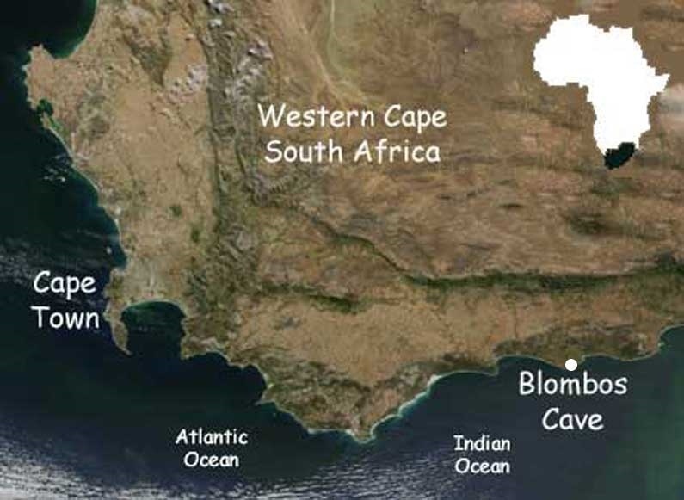
Can We Do It?
Can We Afford Not To?
Thank You
Walter Brown: walbrown@mail.ngo.za
Notes:
166

